Slide 1
SAFETY SYSTEM FOR UNDERGROUND MINE WORKERS
Nishyanth varun reddy Somagattu
Anantha Reddy Pingili
Srinivasa Aditya Preetham
Nalla Shivashanth reddy

Slide 2
AIM OF OUR PROJECT
The main objective of the project is to develop a monitoring system for the safety of workers in the underground mines.
This will alert the workers who are working in the mines when there is any danger.

Slide 3
ABSTRACT
Mining industry is one of the most productive industry .
But there are many risks in mining .
There is a chance for fire accidents and there may be a sudden rise of temperature .
There are many dangerous gases that might release during mining which are dangerous to miner’s health .
To overcome this we will use sensors which detects dangerous and harmful gases , a sensor to detect alcohol which tells us whether the worker is drunk or not , and sensors to detect any fire accident and high temperature .
This data will be communicated through Zigbee and SMS alert will be sent via GSM and everything will be built on ARDUINO.

Slide 4
INTRODUCTION
Mining involves many risks , especially underground mining as far we consider the safety and health of workers.
The risk is due to we are sending the workers into underground with heavy equipment and machinery and we are drilling into the surface where there will be no sufficient oxygen levels or poor air quality.
There may be mine cave-ins which means sudden collapse of rocks or entire undeground mine.
There may be gas explosions which can kill the workers under a minute.
Thus ,the safety of the workers is a very big concern.

Slide 5
INTRODUCTION
Now a days , the mining industries are taking some precautions bringing awareness among the workers by providing some emergency training on how to save their lives when there is any sudden accident.
Mining industries are providing some special suits / dresses which will save them from high temperatures.
But these are also not sufficient to ensure the safety of the workers completely.

Slide 6
LITERATURE SURVEY
S.No | Author | Title | Inference
1 | Pranjal Hazarika | Implementation of smart safety helmets for coal mine workers | This paper presents implementation of safety helmet for coal mine workers. This helmet is equipped with methane and carbon monoxide gas sensor. This sensor sense the gas and the data is transmitted to the control room wirelessly, through a wireless module called X-Bee connected with the helmet. When the methane or carbon-monoxide gas concentration is beyond the critical level, controller in the control room triggers an alarm and keeps the plant and the workers safe by preventing an upcoming accident.

Slide 7
S.No | Author | Title | Inference
2 | Yongping Wu, Guo Feng, Zhang Meng | The study on coal mine using the bluetooth wireless transmission | During the process of mine development, it is very important to measure the gas concentration in mines. For the present of situation of gas concentration monitoring system, this paper proposes a Bluetooth-based coal mine gas concentration monitoring system design, describes the ideas and specific methods software and hardware design. As a standard of unified global short-range wireless communication, Bluetooth technology is to establish a common low-power, low-cost wireless air interface and controlling software opening system. This paper describes the development background, technical features and the structure of the protocol stack of Bluetooth technology

Slide 8
S.No | Author | Title | Inference
3 | Jason B . Forsyth | Feasibility of Intelligent Monitoring of Construction Workers for Carbon Monoxide Poisoning | This paper presents a feasibility study of a wearable computing system to protect construction workers from carbon monoxide poisoning. A pulse oximetry sensor has been integrated into a typical construction helmet to allow continuous and noninvasive monitoring of workers’ blood gas saturation levels. To show the feasibility of monitoring for carbon monoxide poisoning without subjecting users to dangerous conditions, a prototype for monitoring blood 2 saturation was constructed and tested during a user study involving typical construction tasks to determine its reliability while undergoing motion. As monitoring for O2 and CO simply differ in the number of wavelengths of light employed, if monitoring O2 is feasible, then monitoring for CO will be feasible as well.

Slide 9
S.No | Author | Title | Inference
4 | Gautam Gowrishankankaran and Charles He | Productivity, safety, and regulation in underground coal mining: evidence from disasters and fatalities | Underground coal mining is a dangerous industry where the regulatory state may impose tradeoffs between productivity and safety. We recover the marginal tradeoffs using disasters near a mine as shocks that increase future accident costs. We find that in the second year after a disaster, productivity decreases 11% and accident rates decrease 18-80% for mines in the same state, with some evidence that the number of managers increases. Using published “value of statistical life” and injury cost estimates, we find that the productivity loss following a disaster in the same state costs 2.51 times the value of the safety increases.

Slide 10
S.No | Author | Title | Inference
5 | Chandrasekhar S | An Intelligent Ultrasonic Helmet system for Miner | This project primarily focuses on navigation through underground ways in the Mining Industries and aroundlarge objects without sight, through the use of an ultrasonicrangefinder that haptically interfaces with the user via tinyvibrating motors mounted on the user's head. These features areachieved with the help of a microcontroller. The MCU (MicroController Unit) is interfaced via Darlington array to loadvibrators, which vibrate in varying intensities individuallyindicating direction based on the ultrasonic sensor output. Theultrasonic sensor is directly interfaced to MCU, which rotates 0°and 360o with aid of stepper motor. In navigation when obstacleis sensed by sensor, the vibrators indicate obstacle to userindicating the obstacle distance through ZigBee transmitter. Thevibrators intensify as obstacle nears. The entire process can beobserved in nearest computer unit with aid ZigBee receiving unit

Slide 11
PROPOSED SYSTEM
In this project we are implementing different gas sensors , temperature humidity sensors in coal mines.
By this if any harmful gases are detected.
These are communicated by using Zigbee protocol.
The application for the overall system is developed using Arduino.
Hardware modules used on transmitter side are a gas sensor , a fire sensor ,an alcohol sensor and DHT sensor to measure the Temperature and Humidity, Zigbee wireless module and LCD module for monitoring.
Hardware modules used on receiver side is Zigbee wireless module to receive the data and LCD module for monitoring

Slide 12
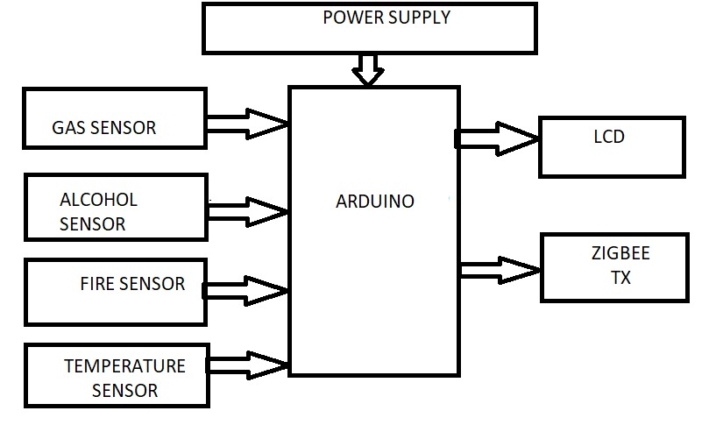
BLOCK DIAGRAM

Slide 13
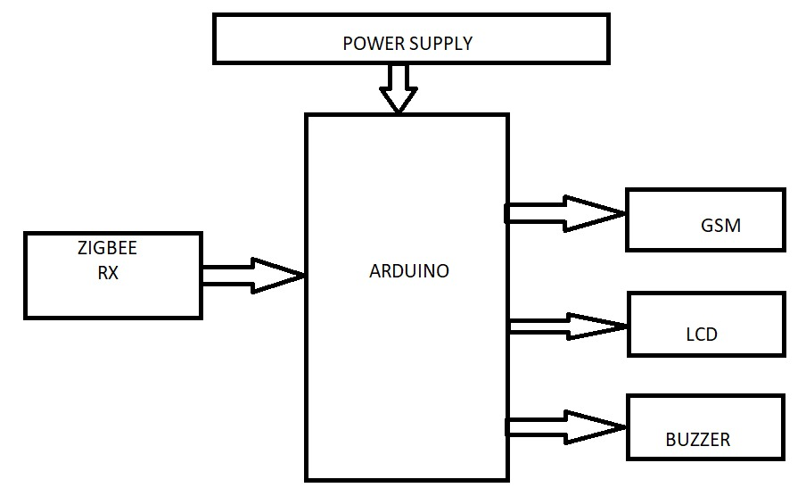

Slide 14
COMPONENTS REQUIRED
HARDWARE:
Arduino (any model)
Zigbee Module
16x2 LCD Display
MQ2 Sensor
MQ6 Sensor
DHT11 Sensor
IR Sensor
Power Supply
Connecting wires
SOFTWARE:
Arduino IDE
Embedded C

Slide 15
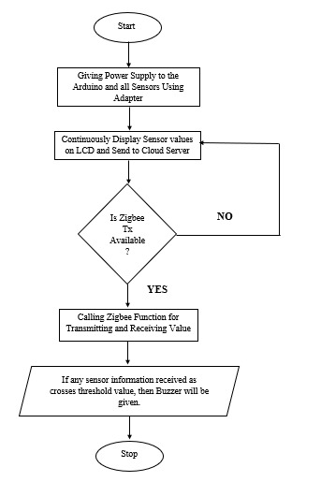
FLOW CHART

Slide 16
WORKING EXPLANATION
In this project We will be placing the transmitter side circuit in the mining area .
The sensors which we used will be monitoring the environment continuously .
If any dangerous gas releases or if there is any sudden rise of temperature in the mining area where workers are working or if there is any fire accident or if there is any worker working after consuming alcohol , the data will be displayed on the LCD and the buzzer will turn on automatically .
The data will be transmitted to the receiver end or the supervising person at the mine through Zigbee protocol .
Also the SMS alert will be sent to any person or nearby hospitals with the help of GSM module

Slide 17
ADVANTAGES
The Leakage of dangerous and harmful gases can be identified.
Accident occurrence can be decreased
High tempeature and fire accidents will be identified

Slide 18
APPLICATIONS
We can use this monitoring system in
- Coal Mines
- Gas Industries

Slide 19
CONCLUSION
A Real time monitoring system is developed to provide clearer and more point to point perspective of the underground mines
This system will be displaying the parameters on the monitoring unit
It will be helpful to all miners present inside the mine to save their life before any accident.
The Alarm triggers when sensor detects any danger inside coal mine.

Slide 20


